Slide 1

DIGITAL LOGIC DESIGN (111776)
Dr. Owais Hussain

Slide 2
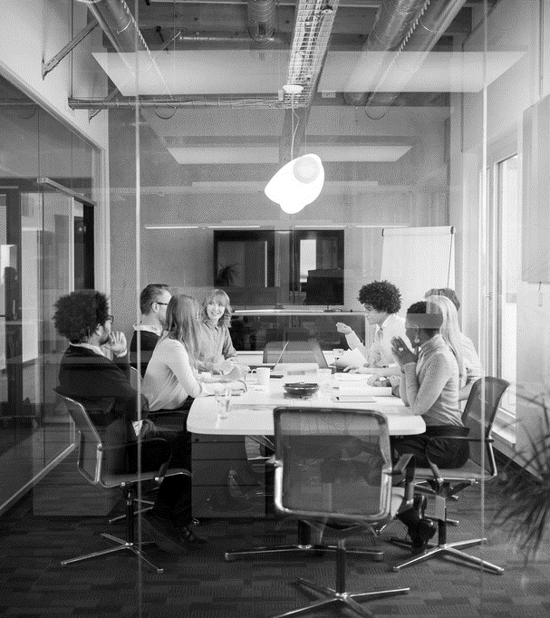
Agenda
The Karnaugh Map
2 Variables
3 Variables
4 Variables
5 Variables

Slide 3
Sample 2
The Karnaugh Map
Methods like Karnaugh map, Quine McCluskey and Espresso algorithms are meant to simplify a Boolean expression.
The Karnaugh Map is used to extract the simplest SOP and POS forms.
This map shows all possible values of an expression, similar to Truth table. However, the representation is in a different form.
We put the 0,1 as row and column headers and expressions inside cells.
Karnaugh map has usually used for 3, 4, or a maximum of 5 variables.

Slide 4
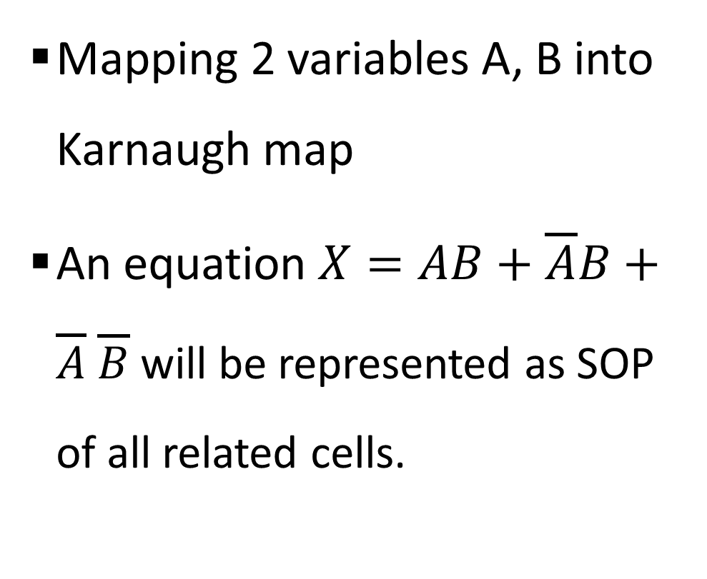
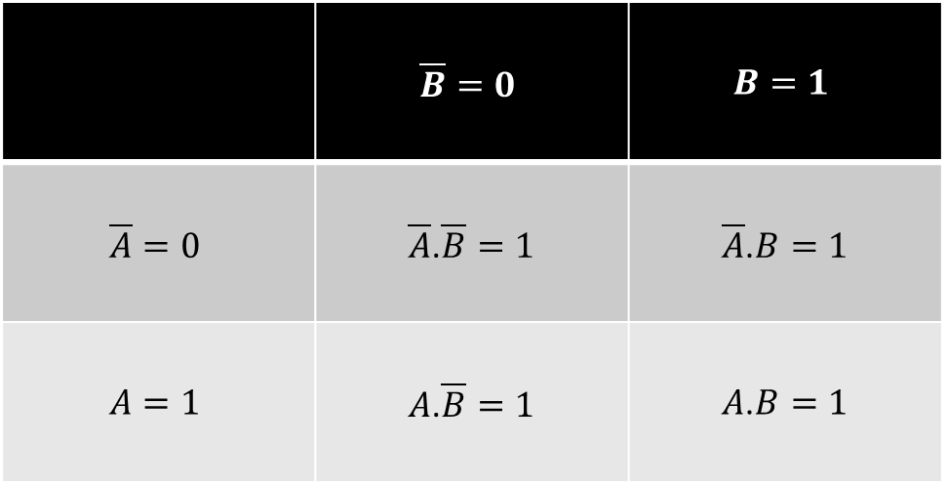
Sample 2
2 Variables
Mapping 2 variables A, B into Karnaugh map
An equation $X=AB+\overline{A}B+\overline{A} \overline{B}$ will be represented as SOP of all related cells.
 | $$\overline{B}=0$$ | $$B=1$$
$$\overline{A}=0$$ | $\overline{A}$.$\overline{B}=1$ | $\overline{A}$.$B=1$
$$A=1$$ | $A$.$\overline{B}=1$ | $A$.$B=1$

Slide 5
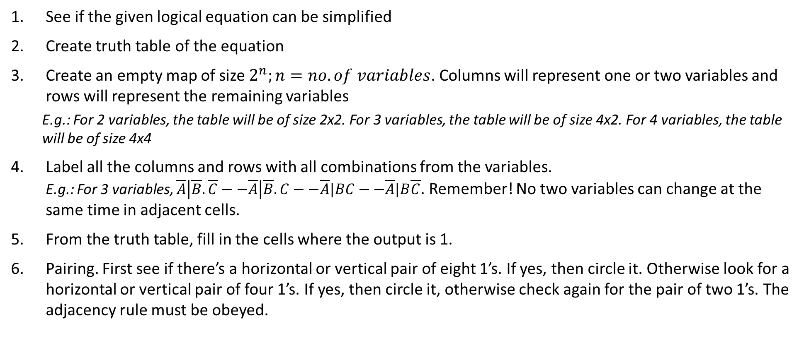
Sample 2
Steps
See if the given logical equation can be simplified
Create truth table of the equation
Create an empty map of size $2^{n};n=no. of variables$. Columns will represent one or two variables and rows will represent the remaining variables
E.g.: For 2 variables, the table will be of size 2x2. For 3 variables, the table will be of size 4x2. For 4 variables, the table will be of size 4x4
Label all the columns and rows with all combinations from the variables. E.g.: For 3 variables, $\overline{A}\left|\overline{B}.\overline{C}−−\overline{A}\right|\overline{B}.C−−\overline{A}|BC−−\overline{A}|B\overline{C}$. Remember! No two variables can change at the same time in adjacent cells.
From the truth table, fill in the cells where the output is 1.
Pairing. First see if there’s a horizontal or vertical pair of eight 1’s. If yes, then circle it. Otherwise look for a horizontal or vertical pair of four 1’s. If yes, then circle it, otherwise check again for the pair of two 1’s. The adjacency rule must be obeyed.

Slide 6
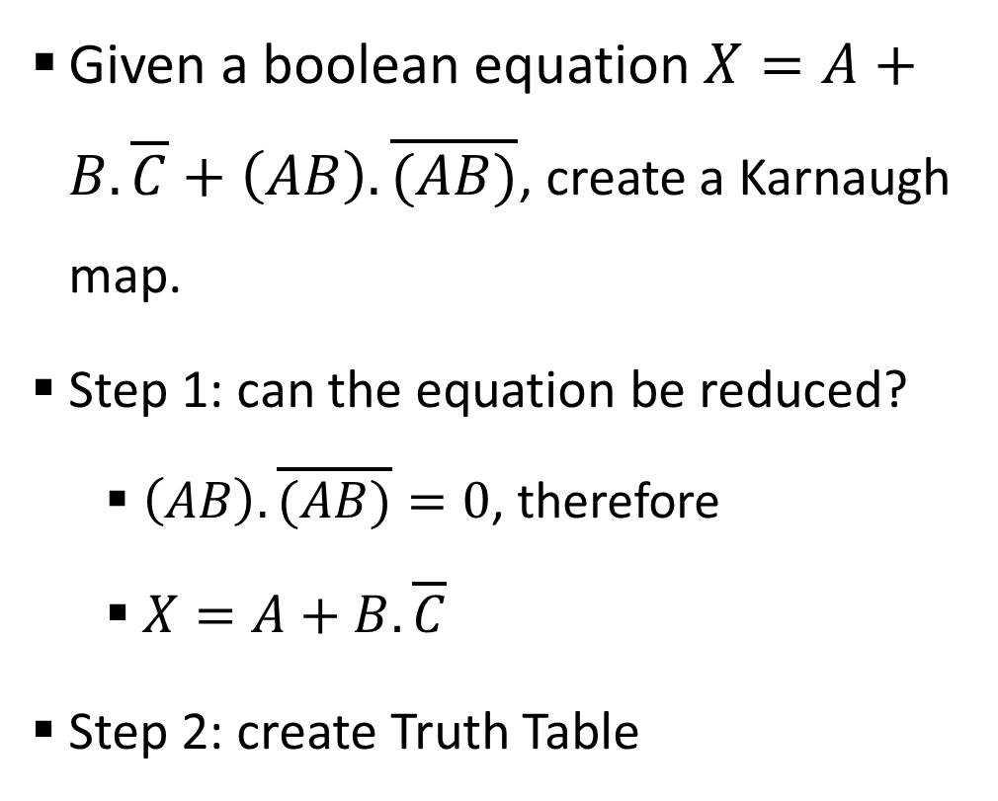
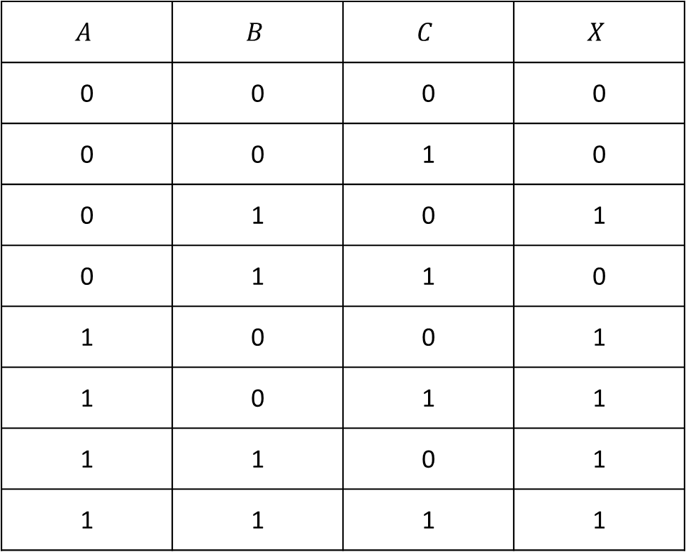
Sample 2
3 Variables
Given a boolean equation $X=A+B.\overline{C}+\left(AB\right).\overline{(AB)}$, create a Karnaugh map.
Step 1: can the equation be reduced?
$\left(AB\right).\overline{(AB)}=0$, therefore
$X=A+B.\overline{C}$
Step 2: create Truth Table
$$A$$ | $$B$$ | $$C$$ | $$X$$
0 | 0 | 0 | 0
0 | 0 | 1 | 0
0 | 1 | 0 | 1
0 | 1 | 1 | 0
1 | 0 | 0 | 1
1 | 0 | 1 | 1
1 | 1 | 0 | 1
1 | 1 | 1 | 1

Slide 7
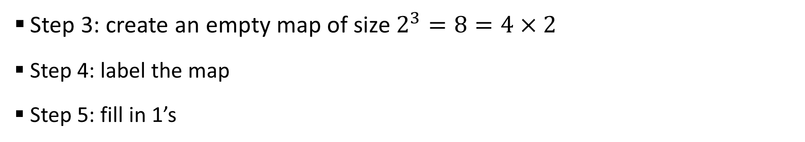
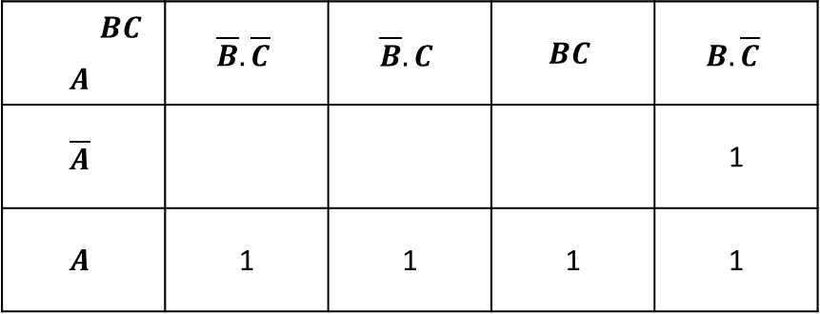
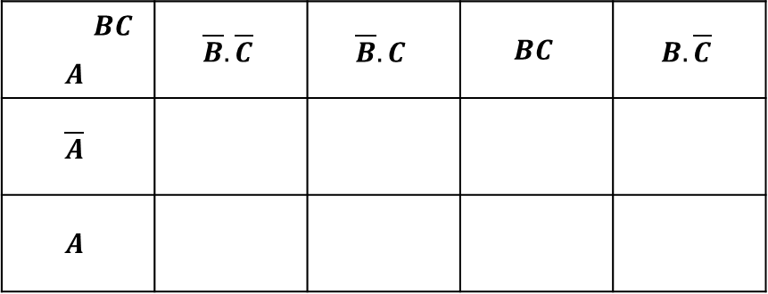
Sample 2
3 Variables
Step 3: create an empty map of size $2^{3}=8=4×2$
Step 4: label the map
Step 5: fill in 1’s
 | $$BC$$ | $$\overline{B}.\overline{C}$$ | $$\overline{B}.C$$ | $$BC$$ | $$B.\overline{C}$$
$$A$$
$$\overline{A}$$
$$A$$
 | $$BC$$ | $$\overline{B}.\overline{C}$$ | $$\overline{B}.C$$ | $$BC$$ | $$B.\overline{C}$$
$$A$$
$$\overline{A}$$ |  |  |  |  | 1
$$A$$ |  | 1 | 1 | 1 | 1

Slide 8
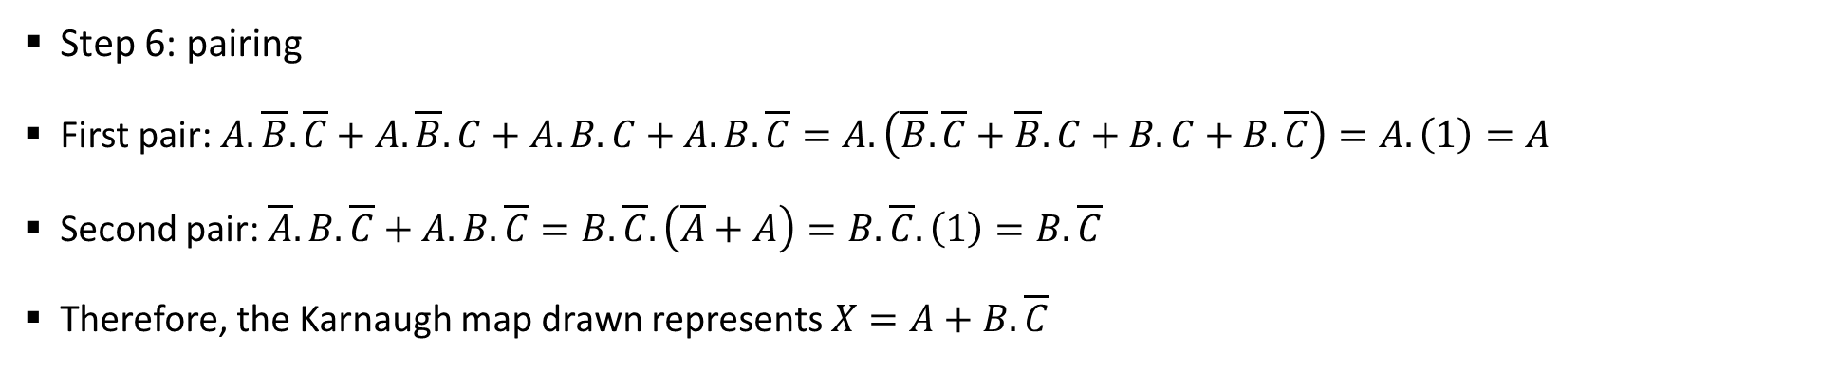
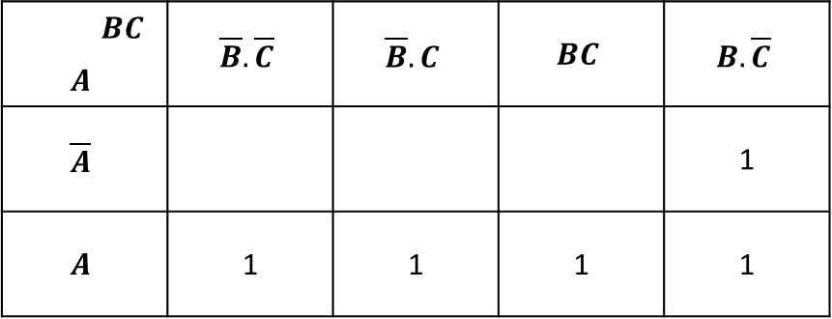
Sample 2
3 Variables
Step 6: pairing
First pair: $A.\overline{B}.\overline{C}+A.\overline{B}.C+A.B.C+A.B.\overline{C}=A.\left(\overline{B}.\overline{C}+\overline{B}.C+B.C+B.\overline{C}\right)=A.\left(1\right)=A$
Second pair: $\overline{A}.B.\overline{C}+A.B.\overline{C}=B.\overline{C}.\left(\overline{A}+A\right)=B.\overline{C}.\left(1\right)=B.\overline{C}$
Therefore, the Karnaugh map drawn represents $X=A+B.\overline{C}$
 | $$BC$$ | $$\overline{B}.\overline{C}$$ | $$\overline{B}.C$$ | $$BC$$ | $$B.\overline{C}$$
$$A$$
$$\overline{A}$$ |  |  |  |  | 1
$$A$$ |  | 1 | 1 | 1 | 1
 | $$BC$$ | $$\overline{B}.\overline{C}$$ | $$\overline{B}.C$$ | $$BC$$ | $$B.\overline{C}$$
$$A$$
$$\overline{A}$$ |  |  |  |  | 1
$$A$$ |  | 1 | 1 | 1 | 1
Notes:
The steps showing simplification are not necessary. You can simply choose the variables which are NOT changing and Add them to create a SOP equation

Slide 9
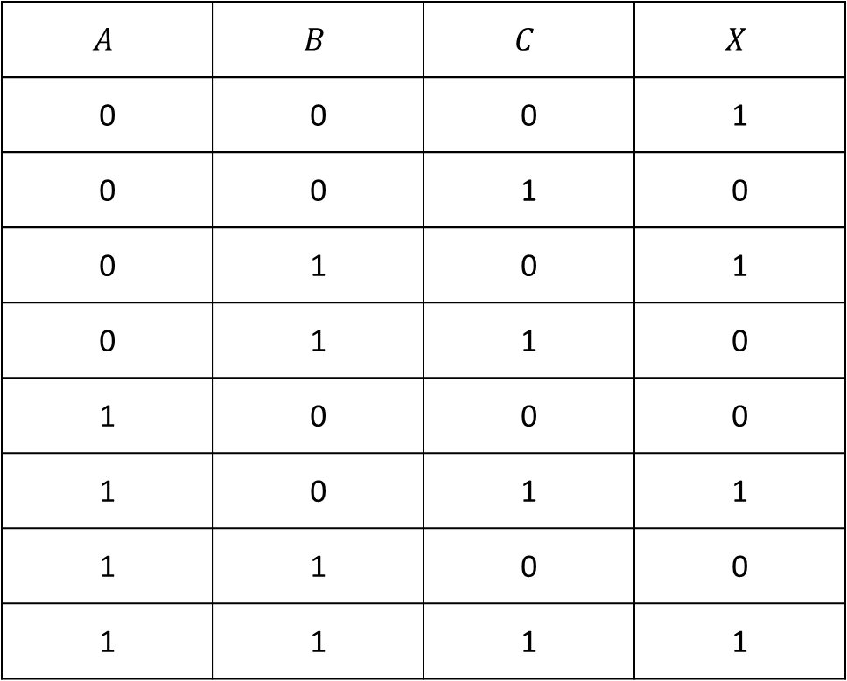
Sample 2
3 Variables - Exercise
From given truth table, find out the logical equation using Karnaugh map
$$A$$ | $$B$$ | $$C$$ | $$X$$
0 | 0 | 0 | 1
0 | 0 | 1 | 0
0 | 1 | 0 | 1
0 | 1 | 1 | 0
1 | 0 | 0 | 0
1 | 0 | 1 | 1
1 | 1 | 0 | 0
1 | 1 | 1 | 1

Slide 10
Sample 2
3 Variables - Exercise

Slide 11
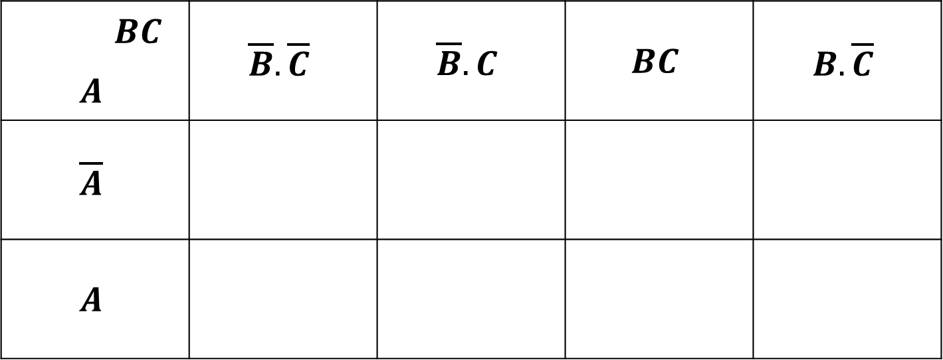
Sample 2
3 Variables - Exercise
 | $$BC$$ | $$\overline{B}.\overline{C}$$ | $$\overline{B}.C$$ | $$BC$$ | $$B.\overline{C}$$
$$A$$
$$\overline{A}$$
$$A$$

Slide 12
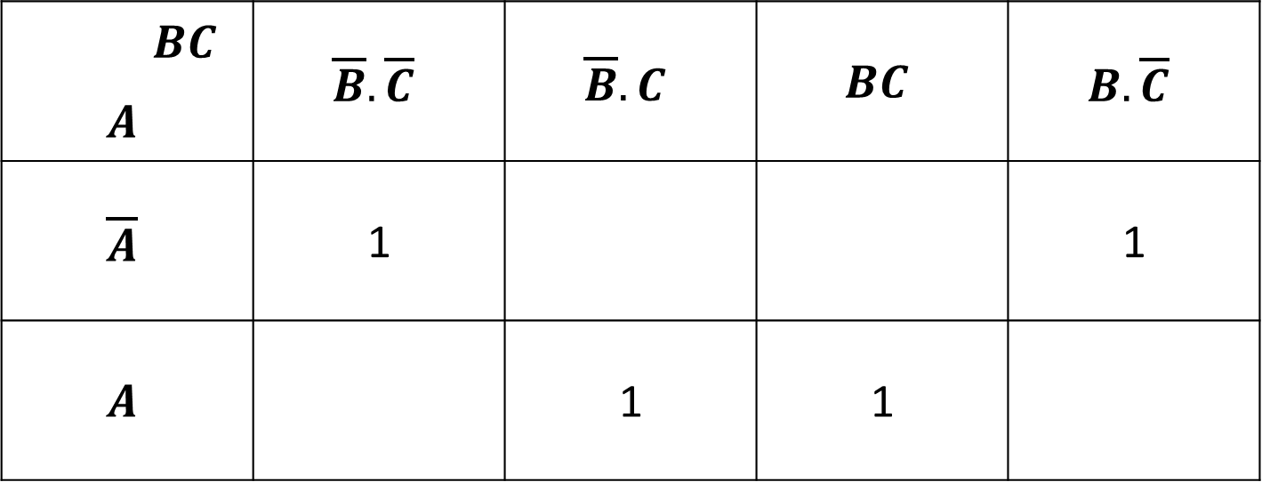
Sample 2
3 Variables - Exercise
 | $$BC$$ | $$\overline{B}.\overline{C}$$ | $$\overline{B}.C$$ | $$BC$$ | $$B.\overline{C}$$
$$A$$
$$\overline{A}$$ |  | 1 |  |  | 1
$$A$$ |  |  | 1 | 1

Slide 13
Sample 2
3 Variables - Exercise
 | $$BC$$ | $$\overline{B}.\overline{C}$$ | $$\overline{B}.C$$ | $$BC$$ | $$B.\overline{C}$$
$$A$$
$$\overline{A}$$ |  | 1 |  |  | 1
$$A$$ |  |  | 1 | 1

Slide 14
Sample 2
3 Variables - Exercise
 | $$BC$$ | $$\overline{B}.\overline{C}$$ | $$\overline{B}.C$$ | $$BC$$ | $$B.\overline{C}$$
$$A$$
$$\overline{A}$$ |  | 1 |  |  | 1
$$A$$ |  |  | 1 | 1

Slide 15
Sample 2
3 Variables - Exercise
 | $$BC$$ | $$\overline{B}.\overline{C}$$ | $$\overline{B}.C$$ | $$BC$$ | $$B.\overline{C}$$
$$A$$
$$\overline{A}$$ |  | 1 |  |  | 1
$$A$$ |  |  | 1 | 1
Solution: $X=A.C+\overline{A}.\overline{C}$

Slide 16
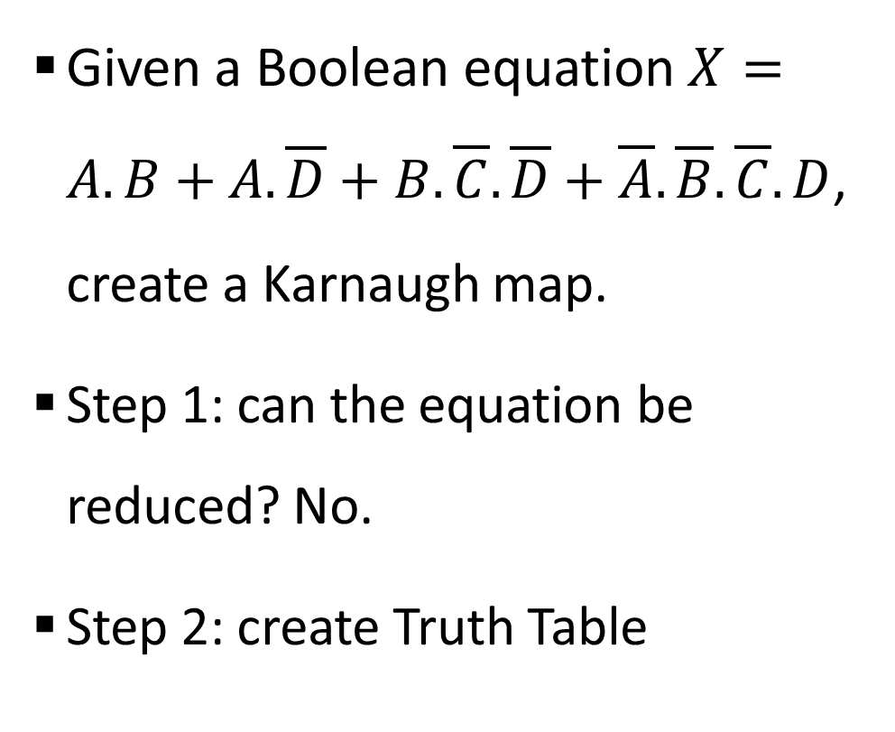
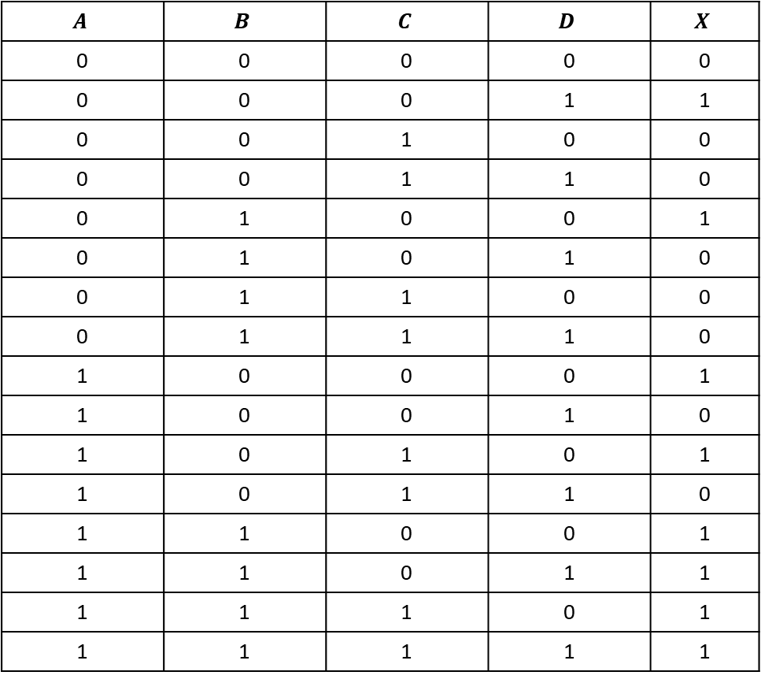
Sample 2
4 Variables
Given a Boolean equation $X=A.B+A.\overline{D}+B.\overline{C}.\overline{D}+\overline{A}.\overline{B}.\overline{C}.D$, create a Karnaugh map.
Step 1: can the equation be reduced? No.
Step 2: create Truth Table
$$A$$ | $$B$$ | $$C$$ | $$D$$ | $$X$$
0 | 0 | 0 | 0 | 0
0 | 0 | 0 | 1 | 1
0 | 0 | 1 | 0 | 0
0 | 0 | 1 | 1 | 0
0 | 1 | 0 | 0 | 1
0 | 1 | 0 | 1 | 0
0 | 1 | 1 | 0 | 0
0 | 1 | 1 | 1 | 0
1 | 0 | 0 | 0 | 1
1 | 0 | 0 | 1 | 0
1 | 0 | 1 | 0 | 1
1 | 0 | 1 | 1 | 0
1 | 1 | 0 | 0 | 1
1 | 1 | 0 | 1 | 1
1 | 1 | 1 | 0 | 1
1 | 1 | 1 | 1 | 1

Slide 17
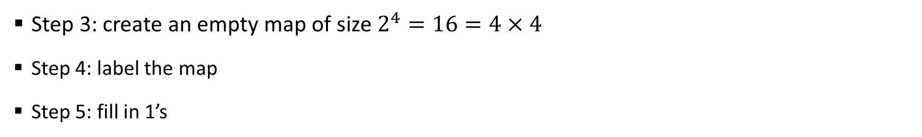
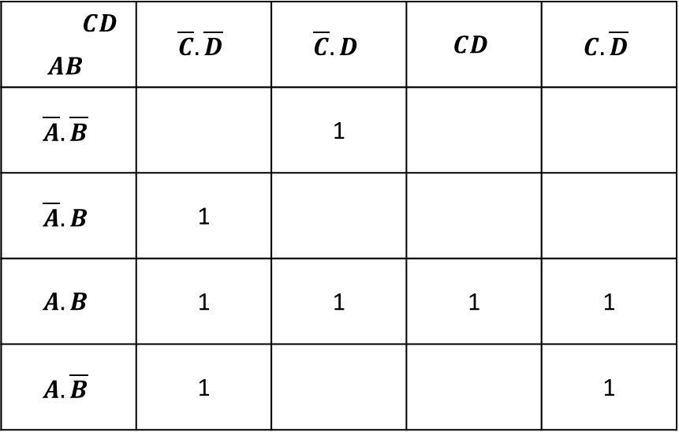
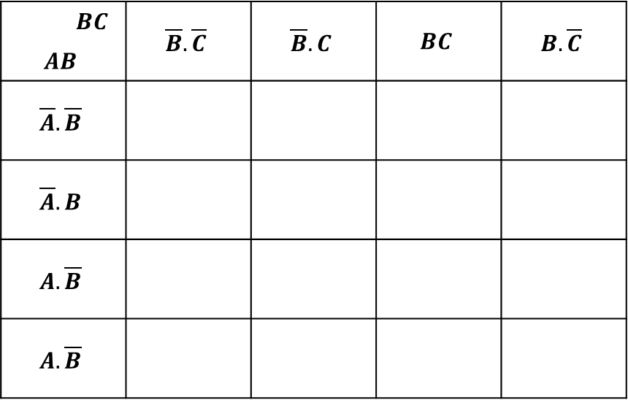
Sample 2
4 Variables
Step 3: create an empty map of size $2^{4}=16=4×4$
Step 4: label the map
Step 5: fill in 1’s
 | $$BC$$ | $$\overline{B}.\overline{C}$$ | $$\overline{B}.C$$ | $$BC$$ | $$B.\overline{C}$$
$$AB$$
$$\overline{A}.\overline{B}$$
$$\overline{A}.B$$
$$A.\overline{B}$$
$$A.\overline{B}$$
 | $$CD$$ | $$\overline{C}.\overline{D}$$ | $$\overline{C}.D$$ | $$CD$$ | $$C.\overline{D}$$
$$AB$$
$$\overline{A}.\overline{B}$$ |  |  | 1
$$\overline{A}.B$$ |  | 1
$$A.B$$ |  | 1 | 1 | 1 | 1
$$A.\overline{B}$$ |  | 1 |  |  | 1

Slide 18
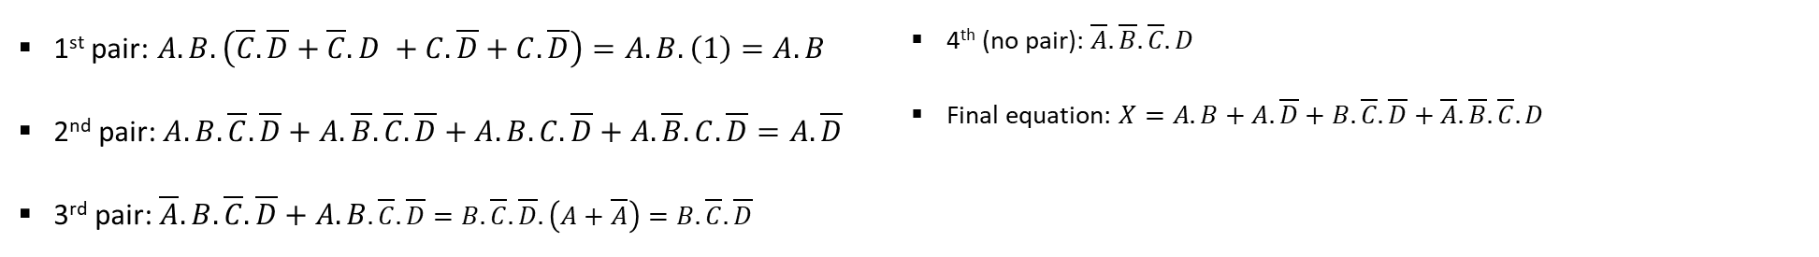
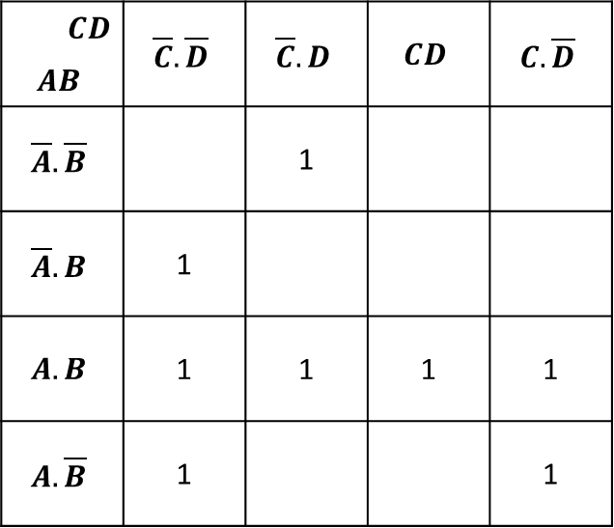
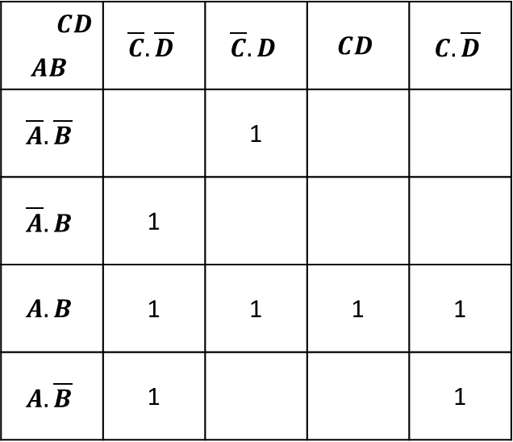
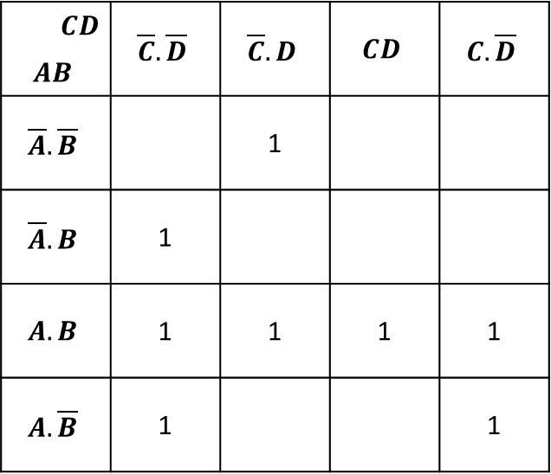
Sample 2
4 Variables
1st pair: $A.B.\left(\overline{C}.\overline{D}+\overline{C}.D +C.\overline{D}+C.\overline{D}\right)=A.B.\left(1\right)=A.B$
2nd pair: $A.B.\overline{C}.\overline{D}+A.\overline{B}.\overline{C}.\overline{D}+A.B.C.\overline{D}+A.\overline{B}.C.\overline{D}=A.\overline{D}$
3rd pair: $\overline{A}.B.\overline{C}.\overline{D}+A.B.\overline{C}.\overline{D}=B. \overline{C}.\overline{D}.\left(A+\overline{A}\right)=B. \overline{C}.\overline{D}$
4th (no pair): $\overline{A}.\overline{B}.\overline{C}.D$
Final equation: $X=A.B+A.\overline{D}+B.\overline{C}.\overline{D}+\overline{A}.\overline{B}.\overline{C}.D$
 | $$CD$$ | $$\overline{C}.\overline{D}$$ | $$\overline{C}.D$$ | $$CD$$ | $$C.\overline{D}$$
$$AB$$
$$\overline{A}.\overline{B}$$ |  |  | 1
$$\overline{A}.B$$ |  | 1
$$A.B$$ |  | 1 | 1 | 1 | 1
$$A.\overline{B}$$ |  | 1 |  |  | 1
 | $$CD$$ | $$\overline{C}.\overline{D}$$ | $$\overline{C}.D$$ | $$CD$$ | $$C.\overline{D}$$
$$AB$$
$$\overline{A}.\overline{B}$$ |  |  | 1
$$\overline{A}.B$$ |  | 1
$$A.B$$ |  | 1 | 1 | 1 | 1
$$A.\overline{B}$$ |  | 1 |  |  | 1
 | $$CD$$ | $$\overline{C}.\overline{D}$$ | $$\overline{C}.D$$ | $$CD$$ | $$C.\overline{D}$$
$$AB$$
$$\overline{A}.\overline{B}$$ |  |  | 1
$$\overline{A}.B$$ |  | 1
$$A.B$$ |  | 1 | 1 | 1 | 1
$$A.\overline{B}$$ |  | 1 |  |  | 1

Slide 19
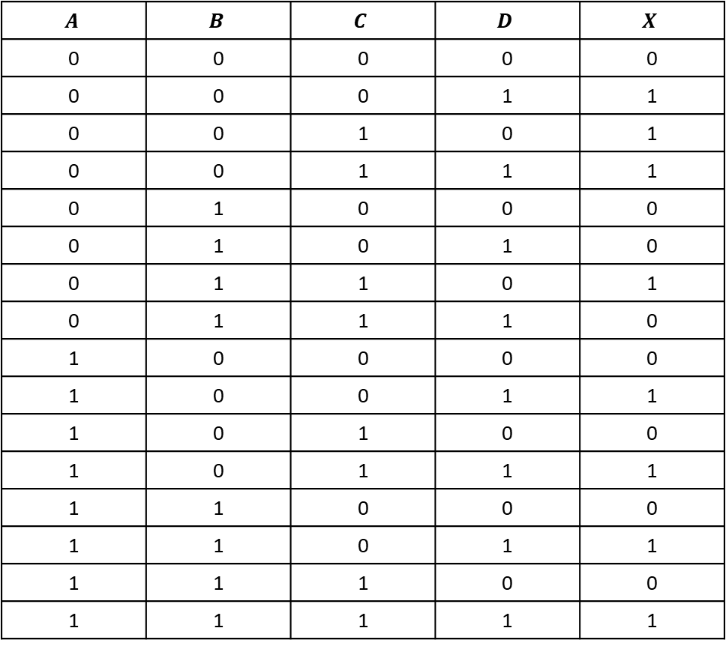
Sample 2
4 Variables - Exercise
$$A$$ | $$B$$ | $$C$$ | $$D$$ | $$X$$
0 | 0 | 0 | 0 | 0
0 | 0 | 0 | 1 | 1
0 | 0 | 1 | 0 | 1
0 | 0 | 1 | 1 | 1
0 | 1 | 0 | 0 | 0
0 | 1 | 0 | 1 | 0
0 | 1 | 1 | 0 | 1
0 | 1 | 1 | 1 | 0
1 | 0 | 0 | 0 | 0
1 | 0 | 0 | 1 | 1
1 | 0 | 1 | 0 | 0
1 | 0 | 1 | 1 | 1
1 | 1 | 0 | 0 | 0
1 | 1 | 0 | 1 | 1
1 | 1 | 1 | 0 | 0
1 | 1 | 1 | 1 | 1
From given truth table, find out the logical equation using Karnaugh map

Slide 20
Sample 2
4 Variables - Exercise

Slide 21
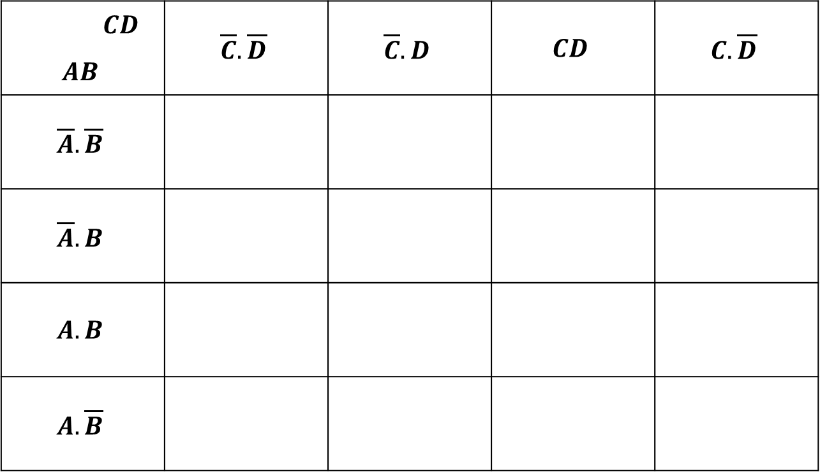
Sample 2
4 Variables - Exercise
 | $$CD$$ | $$\overline{C}.\overline{D}$$ | $$\overline{C}.D$$ | $$CD$$ | $$C.\overline{D}$$
$$AB$$
$$\overline{A}.\overline{B}$$
$$\overline{A}.B$$
$$A.B$$
$$A.\overline{B}$$

Slide 22
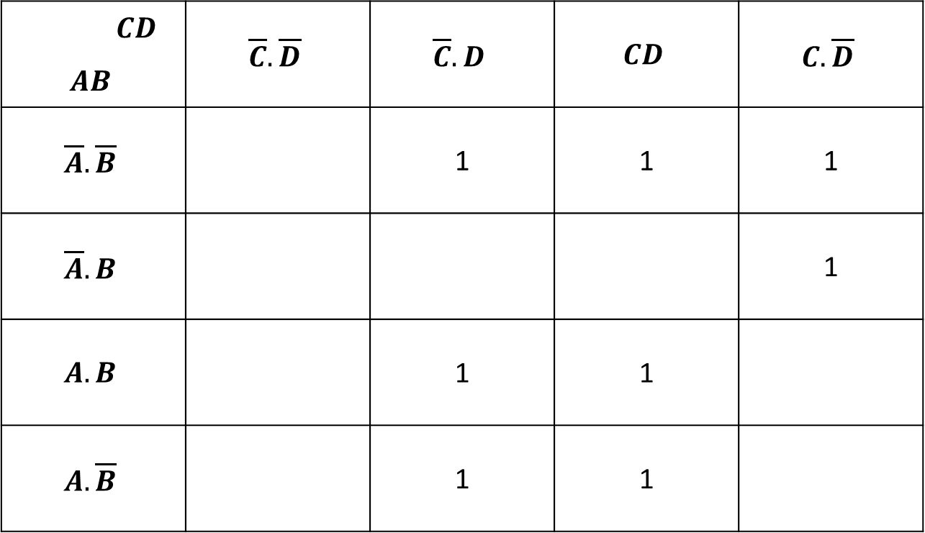
Sample 2
4 Variables - Exercise
 | $$CD$$ | $$\overline{C}.\overline{D}$$ | $$\overline{C}.D$$ | $$CD$$ | $$C.\overline{D}$$
$$AB$$
$$\overline{A}.\overline{B}$$ |  |  | 1 | 1 | 1
$$\overline{A}.B$$ |  |  |  |  | 1
$$A.B$$ |  |  | 1 | 1
$$A.\overline{B}$$ |  |  | 1 | 1

Slide 23
Sample 2
4 Variables - Exercise
 | $$CD$$ | $$\overline{C}.\overline{D}$$ | $$\overline{C}.D$$ | $$CD$$ | $$C.\overline{D}$$
$$AB$$
$$\overline{A}.\overline{B}$$ |  |  | 1 | 1 | 1
$$\overline{A}.B$$ |  |  |  |  | 1
$$A.B$$ |  |  | 1 | 1
$$A.\overline{B}$$ |  |  | 1 | 1

Slide 24
Sample 2
4 Variables - Exercise
 | $$CD$$ | $$\overline{C}.\overline{D}$$ | $$\overline{C}.D$$ | $$CD$$ | $$C.\overline{D}$$
$$AB$$
$$\overline{A}.\overline{B}$$ |  |  | 1 | 1 | 1
$$\overline{A}.B$$ |  |  |  |  | 1
$$A.B$$ |  |  | 1 | 1
$$A.\overline{B}$$ |  |  | 1 | 1

Slide 25
Sample 2
4 Variables - Exercise
 | $$CD$$ | $$\overline{C}.\overline{D}$$ | $$\overline{C}.D$$ | $$CD$$ | $$C.\overline{D}$$
$$AB$$
$$\overline{A}.\overline{B}$$ |  |  | 1 | 1 | 1
$$\overline{A}.B$$ |  |  |  |  | 1
$$A.B$$ |  |  | 1 | 1
$$A.\overline{B}$$ |  |  | 1 | 1

Slide 26
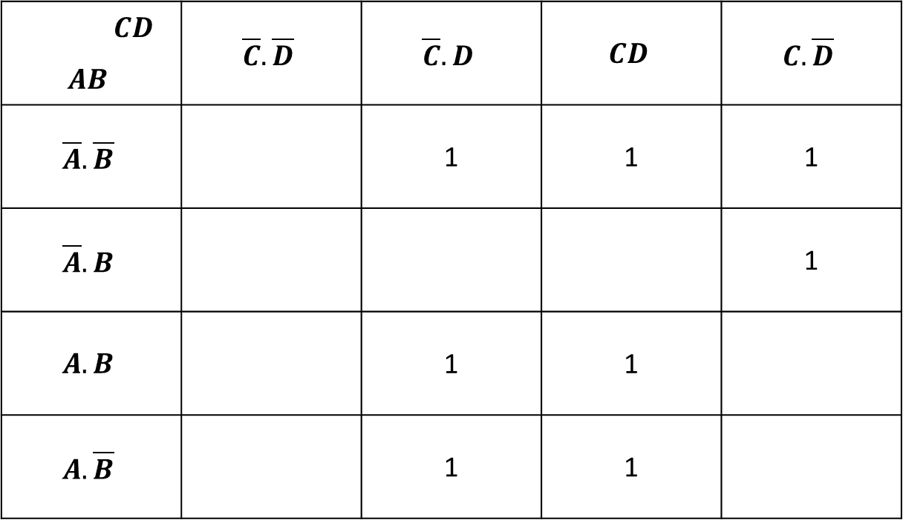
Sample 2
4 Variables - Exercise
 | $$CD$$ | $$\overline{C}.\overline{D}$$ | $$\overline{C}.D$$ | $$CD$$ | $$C.\overline{D}$$
$$AB$$
$$\overline{A}.\overline{B}$$ |  |  | 1 | 1 | 1
$$\overline{A}.B$$ |  |  |  |  | 1
$$A.B$$ |  |  | 1 | 1
$$A.\overline{B}$$ |  |  | 1 | 1
Solution: $X=A.D+\overline{B}.D+\overline{A}.C.\overline{D}$

Slide 27
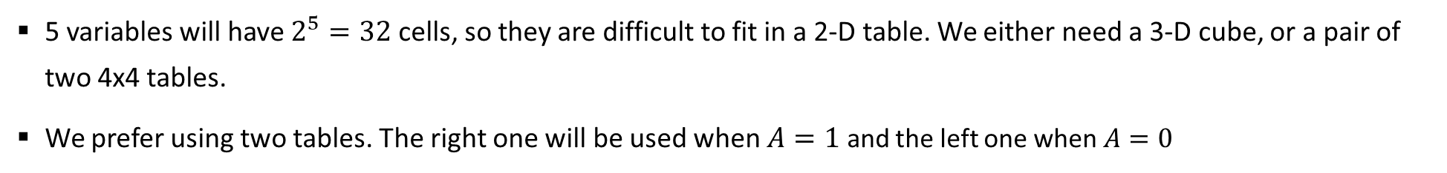
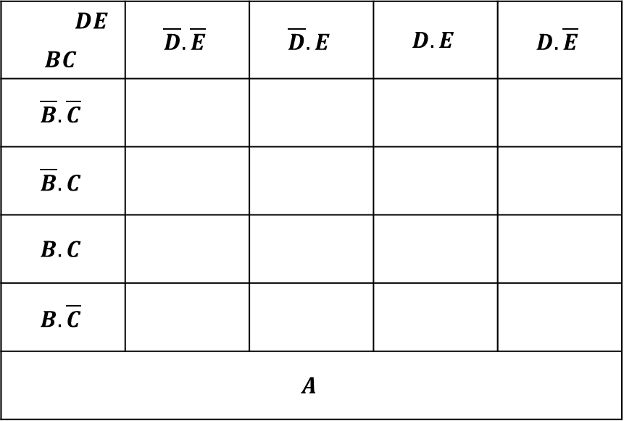
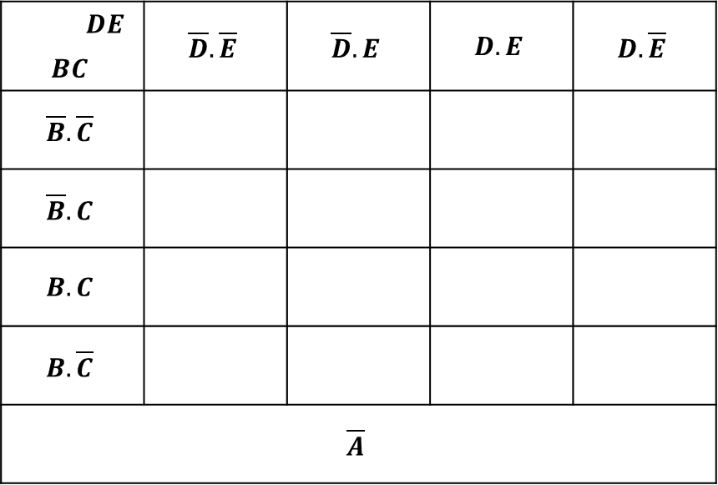
Sample 2
5 Variables
5 variables will have $2^{5}=32$ cells, so they are difficult to fit in a 2-D table. We either need a 3-D cube, or a pair of two 4x4 tables.
We prefer using two tables. The right one will be used when $A=1$ and the left one when $A=0$
 | $$DE$$ | $$\overline{D}.\overline{E}$$ | $$\overline{D}.E$$ | $$D.E$$ | $$D.\overline{E}$$
$$BC$$
$$\overline{B}.\overline{C}$$
$$\overline{B}.C$$
$$B.C$$
$$B.\overline{C}$$
$$\overline{A}$$
 | $$DE$$ | $$\overline{D}.\overline{E}$$ | $$\overline{D}.E$$ | $$D.E$$ | $$D.\overline{E}$$
$$BC$$
$$\overline{B}.\overline{C}$$
$$\overline{B}.C$$
$$B.C$$
$$B.\overline{C}$$
$$A$$

Slide 28
Sample 2
5 Variables
Given a Truth table of 5 variables, find minimal SOP using Karnaugh map
Step 2: Truth Table is already given

Slide 29
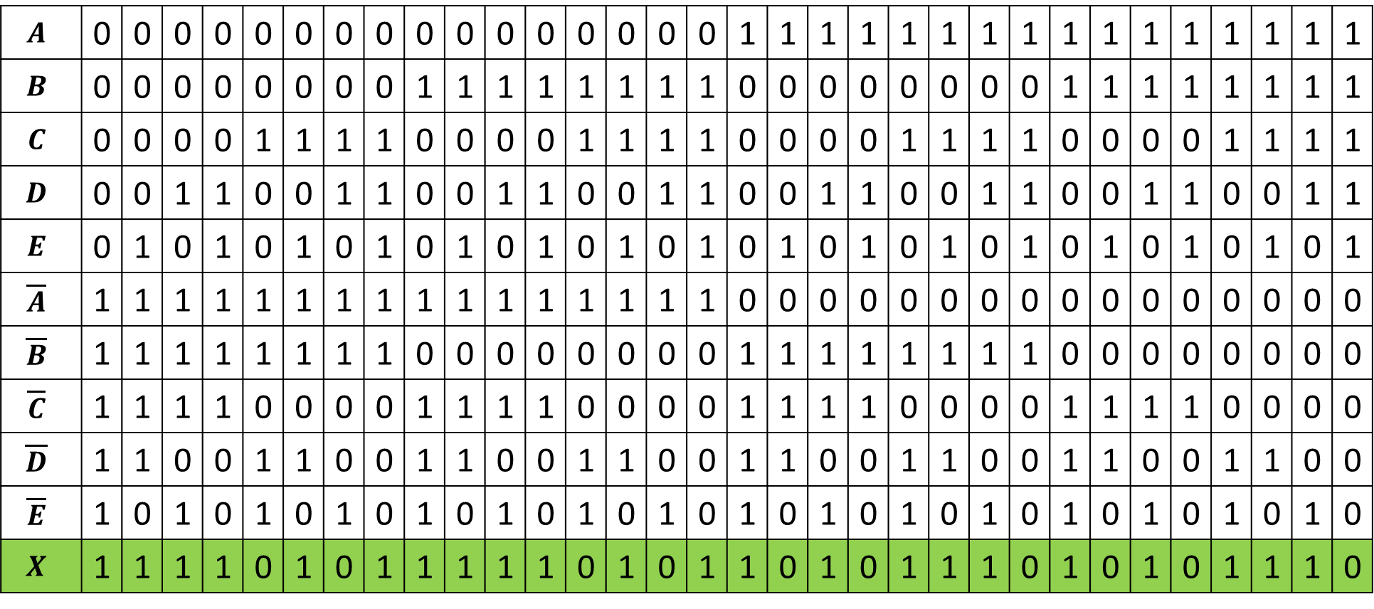
Sample 2
5 Variables
$$A$$ | 0 | 0 | 0 | 0 | 0 | 0 | 0 | 0 | 0 | 0 | 0 | 0 | 0 | 0 | 0 | 0 | 1 | 1 | 1 | 1 | 1 | 1 | 1 | 1 | 1 | 1 | 1 | 1 | 1 | 1 | 1 | 1
$$B$$ | 0 | 0 | 0 | 0 | 0 | 0 | 0 | 0 | 1 | 1 | 1 | 1 | 1 | 1 | 1 | 1 | 0 | 0 | 0 | 0 | 0 | 0 | 0 | 0 | 1 | 1 | 1 | 1 | 1 | 1 | 1 | 1
$$C$$ | 0 | 0 | 0 | 0 | 1 | 1 | 1 | 1 | 0 | 0 | 0 | 0 | 1 | 1 | 1 | 1 | 0 | 0 | 0 | 0 | 1 | 1 | 1 | 1 | 0 | 0 | 0 | 0 | 1 | 1 | 1 | 1
$$D$$ | 0 | 0 | 1 | 1 | 0 | 0 | 1 | 1 | 0 | 0 | 1 | 1 | 0 | 0 | 1 | 1 | 0 | 0 | 1 | 1 | 0 | 0 | 1 | 1 | 0 | 0 | 1 | 1 | 0 | 0 | 1 | 1
$$E$$ | 0 | 1 | 0 | 1 | 0 | 1 | 0 | 1 | 0 | 1 | 0 | 1 | 0 | 1 | 0 | 1 | 0 | 1 | 0 | 1 | 0 | 1 | 0 | 1 | 0 | 1 | 0 | 1 | 0 | 1 | 0 | 1
$$\overline{A}$$ | 1 | 1 | 1 | 1 | 1 | 1 | 1 | 1 | 1 | 1 | 1 | 1 | 1 | 1 | 1 | 1 | 0 | 0 | 0 | 0 | 0 | 0 | 0 | 0 | 0 | 0 | 0 | 0 | 0 | 0 | 0 | 0
$$\overline{B}$$ | 1 | 1 | 1 | 1 | 1 | 1 | 1 | 1 | 0 | 0 | 0 | 0 | 0 | 0 | 0 | 0 | 1 | 1 | 1 | 1 | 1 | 1 | 1 | 1 | 0 | 0 | 0 | 0 | 0 | 0 | 0 | 0
$$\overline{C}$$ | 1 | 1 | 1 | 1 | 0 | 0 | 0 | 0 | 1 | 1 | 1 | 1 | 0 | 0 | 0 | 0 | 1 | 1 | 1 | 1 | 0 | 0 | 0 | 0 | 1 | 1 | 1 | 1 | 0 | 0 | 0 | 0
$$\overline{D}$$ | 1 | 1 | 0 | 0 | 1 | 1 | 0 | 0 | 1 | 1 | 0 | 0 | 1 | 1 | 0 | 0 | 1 | 1 | 0 | 0 | 1 | 1 | 0 | 0 | 1 | 1 | 0 | 0 | 1 | 1 | 0 | 0
$$\overline{E}$$ | 1 | 0 | 1 | 0 | 1 | 0 | 1 | 0 | 1 | 0 | 1 | 0 | 1 | 0 | 1 | 0 | 1 | 0 | 1 | 0 | 1 | 0 | 1 | 0 | 1 | 0 | 1 | 0 | 1 | 0 | 1 | 0
$$X$$ | 1 | 1 | 1 | 1 | 0 | 1 | 0 | 1 | 1 | 1 | 1 | 1 | 0 | 1 | 0 | 1 | 1 | 0 | 1 | 0 | 1 | 1 | 1 | 0 | 1 | 0 | 1 | 0 | 1 | 1 | 1 | 0
Notes:
$X=A.B+A.C.\overline{D}+A.\overline{B}.C+\overline{A}.\overline{C}+\overline{A}.E+A.\overline{E}$

Slide 30

Sample 2
5 Variables
Step 3: create two empty maps of size $2^{5}=16=4×4$ each

Slide 31
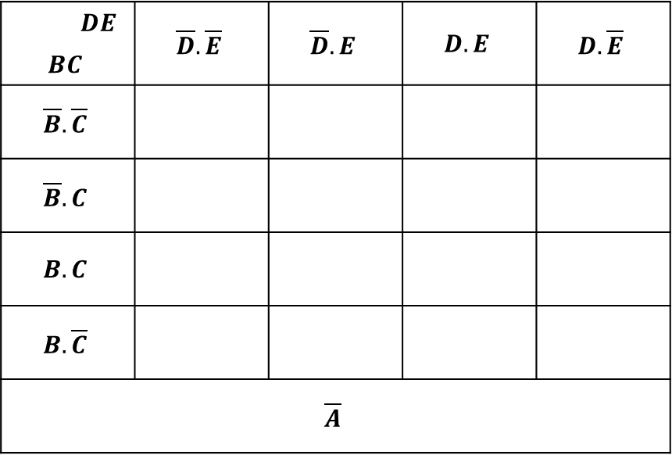
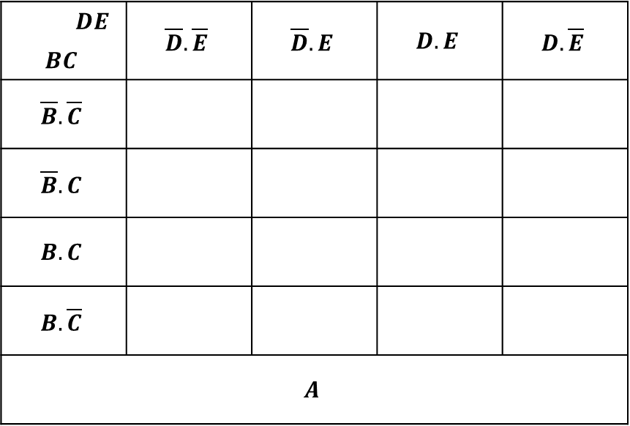
Sample 2
5 Variables
Step 4: label the maps
 | $$DE$$ | $$\overline{D}.\overline{E}$$ | $$\overline{D}.E$$ | $$D.E$$ | $$D.\overline{E}$$
$$BC$$
$$\overline{B}.\overline{C}$$
$$\overline{B}.C$$
$$B.C$$
$$B.\overline{C}$$
$$\overline{A}$$
 | $$DE$$ | $$\overline{D}.\overline{E}$$ | $$\overline{D}.E$$ | $$D.E$$ | $$D.\overline{E}$$
$$BC$$
$$\overline{B}.\overline{C}$$
$$\overline{B}.C$$
$$B.C$$
$$B.\overline{C}$$
$$A$$

Slide 32
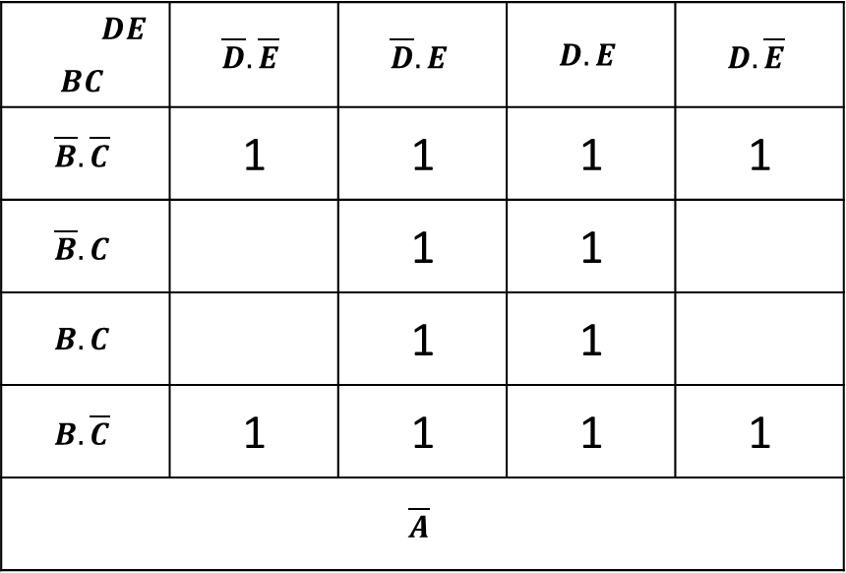
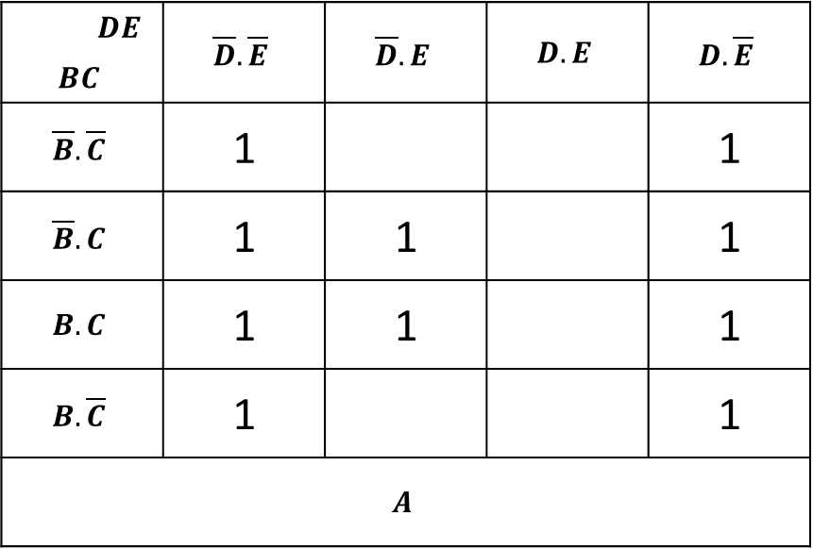
Sample 2
5 Variables
Step 5: fill in 1’s
 | $$DE$$ | $$\overline{D}.\overline{E}$$ | $$\overline{D}.E$$ | $$D.E$$ | $$D.\overline{E}$$
$$BC$$
$$\overline{B}.\overline{C}$$ |  | 1 | 1 | 1 | 1
$$\overline{B}.C$$ |  |  | 1 | 1
$$B.C$$ |  |  | 1 | 1
$$B.\overline{C}$$ |  | 1 | 1 | 1 | 1
$$\overline{A}$$
 | $$DE$$ | $$\overline{D}.\overline{E}$$ | $$\overline{D}.E$$ | $$D.E$$ | $$D.\overline{E}$$
$$BC$$
$$\overline{B}.\overline{C}$$ |  | 1 |  |  | 1
$$\overline{B}.C$$ |  | 1 | 1 |  | 1
$$B.C$$ |  | 1 | 1 |  | 1
$$B.\overline{C}$$ |  | 1 |  |  | 1
$$A$$

Slide 33
Sample 2
5 Variables
Step 6 pairing: Think in 3 dimensions, tables can “overlap" on one another
When pairing on left group only, use RED; when pairing on right group only, use BLUE; when pairing on both groups, use GREEN
 | $$DE$$ | $$\overline{D}.\overline{E}$$ | $$\overline{D}.E$$ | $$D.E$$ | $$D.\overline{E}$$
$$BC$$
$$\overline{B}.\overline{C}$$ |  | 1 | 1 | 1 | 1
$$\overline{B}.C$$ |  |  | 1 | 1
$$B.C$$ |  |  | 1 | 1
$$B.\overline{C}$$ |  | 1 | 1 | 1 | 1
$$\overline{A}$$
 | $$DE$$ | $$\overline{D}.\overline{E}$$ | $$\overline{D}.E$$ | $$D.E$$ | $$D.\overline{E}$$
$$BC$$
$$\overline{B}.\overline{C}$$ |  | 1 |  |  | 1
$$\overline{B}.C$$ |  | 1 | 1 |  | 1
$$B.C$$ |  | 1 | 1 |  | 1
$$B.\overline{C}$$ |  | 1 |  |  | 1
$$A$$

Slide 34
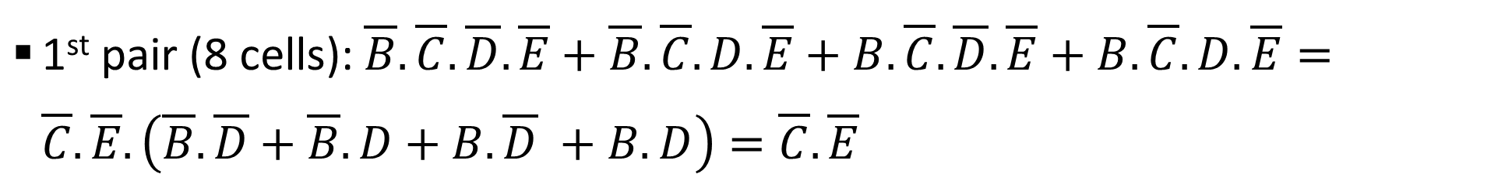
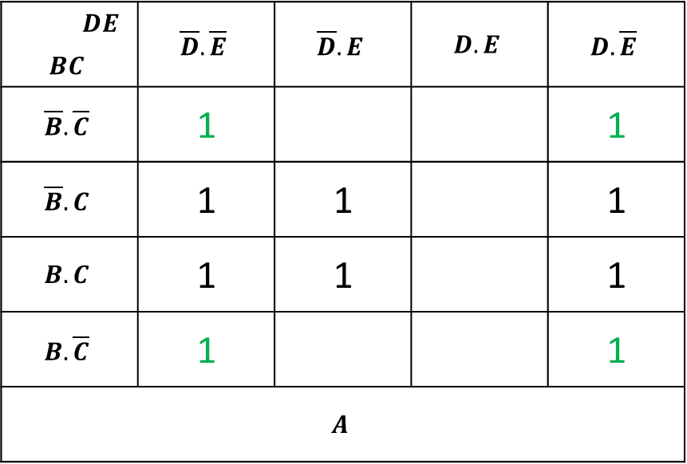
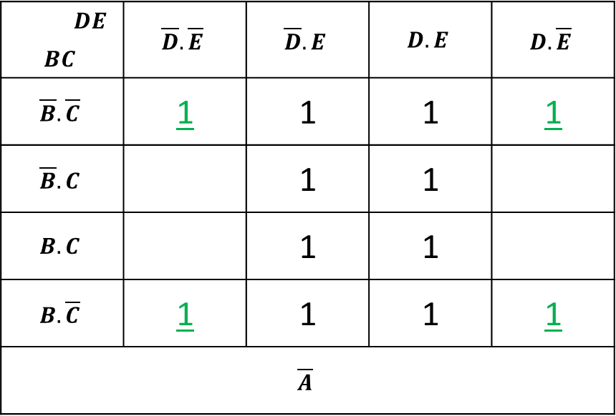
Sample 2
5 Variables
1st pair (8 cells): $\overline{B}.\overline{C}.\overline{D}.\overline{E}+\overline{B}.\overline{C}.D.\overline{E}+B.\overline{C}.\overline{D}.\overline{E}+B.\overline{C}.D.\overline{E}=\overline{C}.\overline{E}.\left(\overline{B}. \overline{D}+\overline{B}. D+B. \overline{D} +B. D\right)=\overline{C}.\overline{E}$
 | $$DE$$ | $$\overline{D}.\overline{E}$$ | $$\overline{D}.E$$ | $$D.E$$ | $$D.\overline{E}$$
$$BC$$
$$\overline{B}.\overline{C}$$ |  | 1 | 1 | 1 | 1
$$\overline{B}.C$$ |  |  | 1 | 1
$$B.C$$ |  |  | 1 | 1
$$B.\overline{C}$$ |  | 1 | 1 | 1 | 1
$$\overline{A}$$
 | $$DE$$ | $$\overline{D}.\overline{E}$$ | $$\overline{D}.E$$ | $$D.E$$ | $$D.\overline{E}$$
$$BC$$
$$\overline{B}.\overline{C}$$ |  | 1 |  |  | 1
$$\overline{B}.C$$ |  | 1 | 1 |  | 1
$$B.C$$ |  | 1 | 1 |  | 1
$$B.\overline{C}$$ |  | 1 |  |  | 1
$$A$$

Slide 35

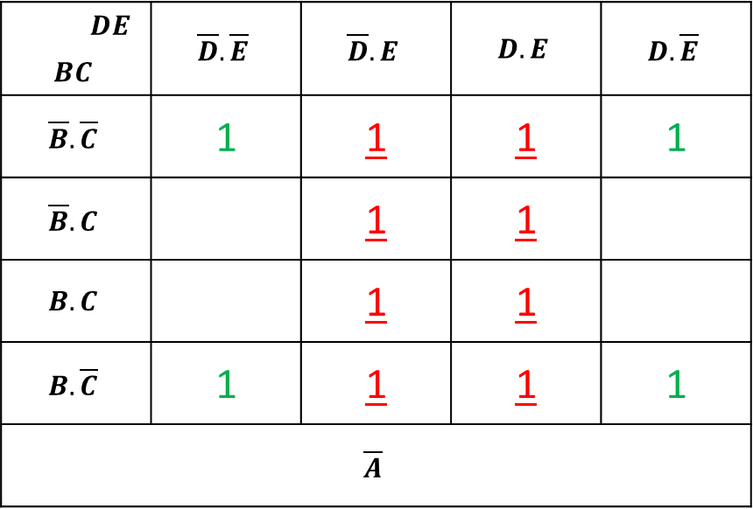
Sample 2
5 Variables
2nd pair (8 cells): $\overline{A}.E$
 | $$DE$$ | $$\overline{D}.\overline{E}$$ | $$\overline{D}.E$$ | $$D.E$$ | $$D.\overline{E}$$
$$BC$$
$$\overline{B}.\overline{C}$$ |  | 1 | 1 | 1 | 1
$$\overline{B}.C$$ |  |  | 1 | 1
$$B.C$$ |  |  | 1 | 1
$$B.\overline{C}$$ |  | 1 | 1 | 1 | 1
$$\overline{A}$$
 | $$DE$$ | $$\overline{D}.\overline{E}$$ | $$\overline{D}.E$$ | $$D.E$$ | $$D.\overline{E}$$
$$BC$$
$$\overline{B}.\overline{C}$$ |  | 1 |  |  | 1
$$\overline{B}.C$$ |  | 1 | 1 |  | 1
$$B.C$$ |  | 1 | 1 |  | 1
$$B.\overline{C}$$ |  | 1 |  |  | 1
$$A$$

Slide 36
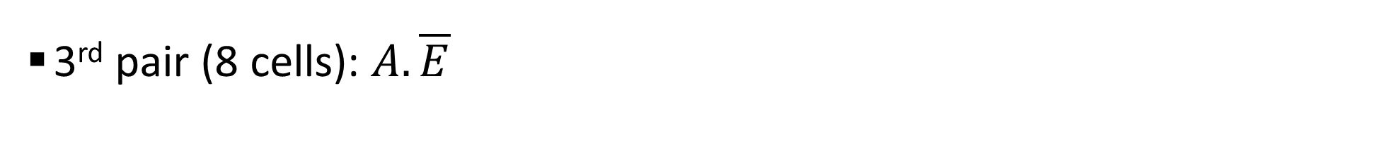
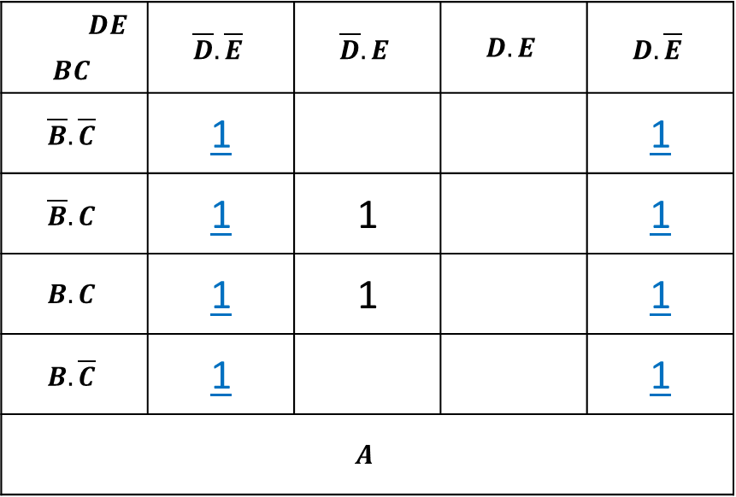
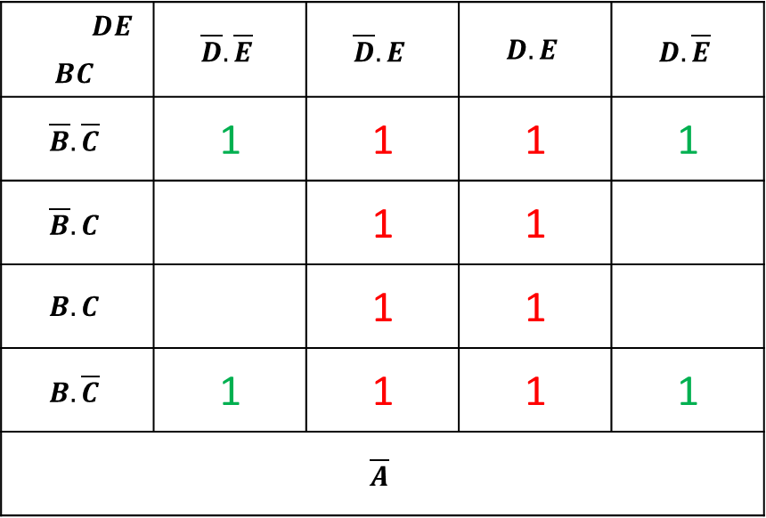
Sample 2
5 Variables
3rd pair (8 cells): $A.\overline{E}$
 | $$DE$$ | $$\overline{D}.\overline{E}$$ | $$\overline{D}.E$$ | $$D.E$$ | $$D.\overline{E}$$
$$BC$$
$$\overline{B}.\overline{C}$$ |  | 1 | 1 | 1 | 1
$$\overline{B}.C$$ |  |  | 1 | 1
$$B.C$$ |  |  | 1 | 1
$$B.\overline{C}$$ |  | 1 | 1 | 1 | 1
$$\overline{A}$$
 | $$DE$$ | $$\overline{D}.\overline{E}$$ | $$\overline{D}.E$$ | $$D.E$$ | $$D.\overline{E}$$
$$BC$$
$$\overline{B}.\overline{C}$$ |  | 1 |  |  | 1
$$\overline{B}.C$$ |  | 1 | 1 |  | 1
$$B.C$$ |  | 1 | 1 |  | 1
$$B.\overline{C}$$ |  | 1 |  |  | 1
$$A$$

Slide 37

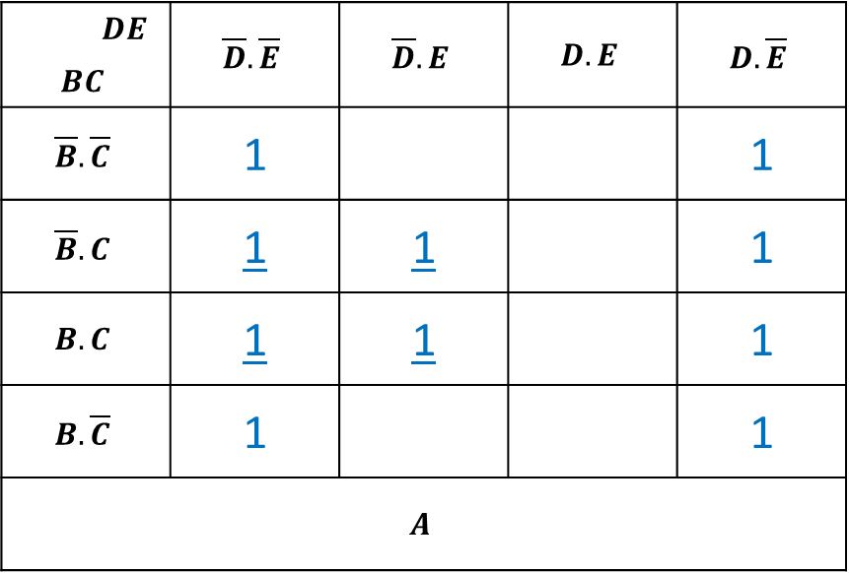
Sample 2
5 Variables
4th pair (4 cells): $A.C.\overline{D}$
 | $$DE$$ | $$\overline{D}.\overline{E}$$ | $$\overline{D}.E$$ | $$D.E$$ | $$D.\overline{E}$$
$$BC$$
$$\overline{B}.\overline{C}$$ |  | 1 | 1 | 1 | 1
$$\overline{B}.C$$ |  |  | 1 | 1
$$B.C$$ |  |  | 1 | 1
$$B.\overline{C}$$ |  | 1 | 1 | 1 | 1
$$\overline{A}$$
 | $$DE$$ | $$\overline{D}.\overline{E}$$ | $$\overline{D}.E$$ | $$D.E$$ | $$D.\overline{E}$$
$$BC$$
$$\overline{B}.\overline{C}$$ |  | 1 |  |  | 1
$$\overline{B}.C$$ |  | 1 | 1 |  | 1
$$B.C$$ |  | 1 | 1 |  | 1
$$B.\overline{C}$$ |  | 1 |  |  | 1
$$A$$

Slide 38

Sample 2
5 Variables
Solution is: $X=\overline{A}.E+A.\overline{E}+A.C.\overline{D}+\overline{C}.\overline{E}$
 | $$DE$$ | $$\overline{D}.\overline{E}$$ | $$\overline{D}.E$$ | $$D.E$$ | $$D.\overline{E}$$
$$BC$$
$$\overline{B}.\overline{C}$$ |  | 1 | 1 | 1 | 1
$$\overline{B}.C$$ |  |  | 1 | 1
$$B.C$$ |  |  | 1 | 1
$$B.\overline{C}$$ |  | 1 | 1 | 1 | 1
$$\overline{A}$$
 | $$DE$$ | $$\overline{D}.\overline{E}$$ | $$\overline{D}.E$$ | $$D.E$$ | $$D.\overline{E}$$
$$BC$$
$$\overline{B}.\overline{C}$$ |  | 1 |  |  | 1
$$\overline{B}.C$$ |  | 1 | 1 |  | 1
$$B.C$$ |  | 1 | 1 |  | 1
$$B.\overline{C}$$ |  | 1 |  |  | 1
$$A$$

Slide 39
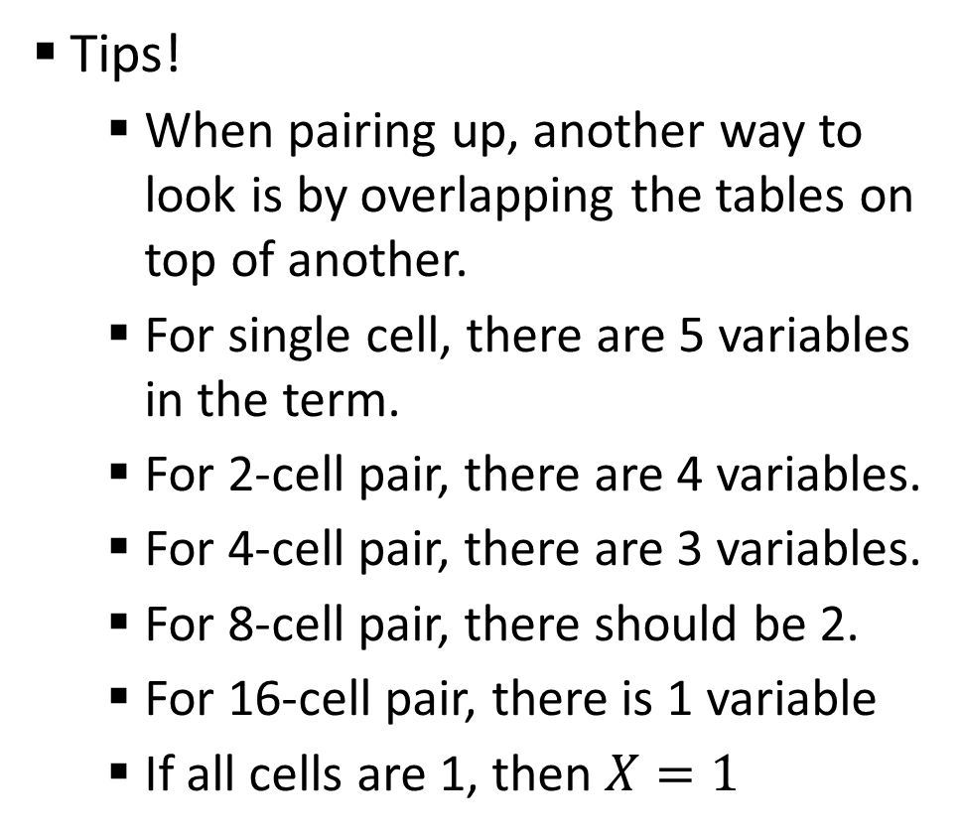
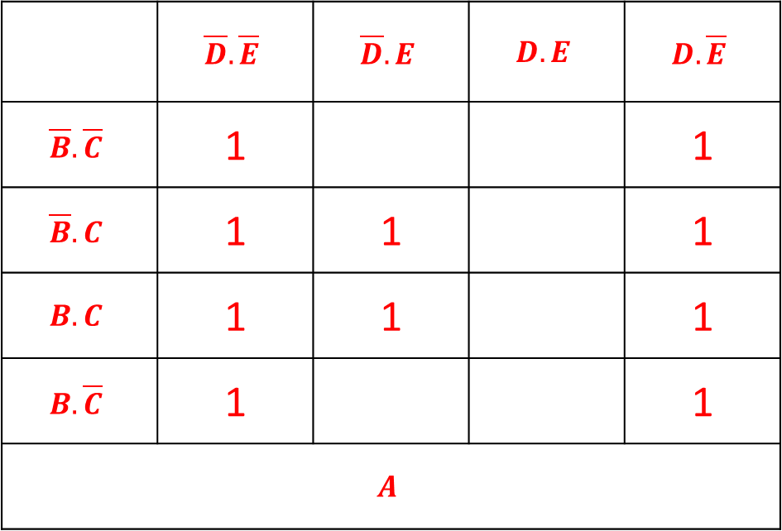
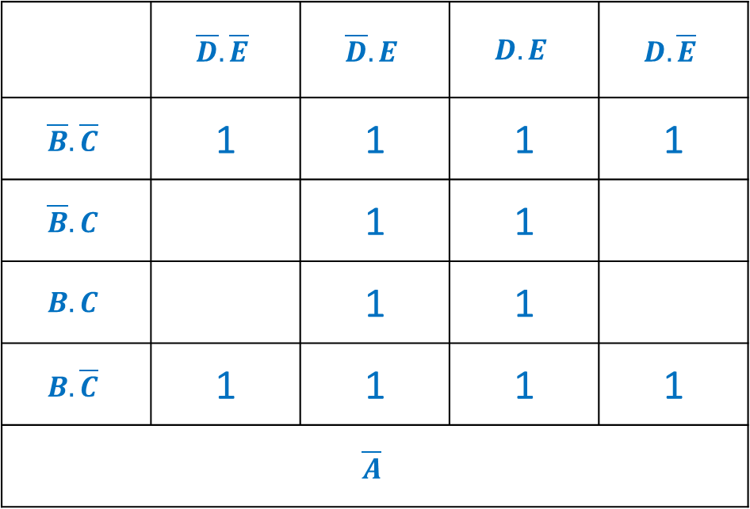
Sample 2
5 Variables
Tips!
When pairing up, another way to look is by overlapping the tables on top of another.
For single cell, there are 5 variables in the term.
For 2-cell pair, there are 4 variables.
For 4-cell pair, there are 3 variables.
For 8-cell pair, there should be 2.
For 16-cell pair, there is 1 variable
If all cells are 1, then $X=1$
 |  | $$\overline{D}.\overline{E}$$ | $$\overline{D}.E$$ | $$D.E$$ | $$D.\overline{E}$$
$$\overline{B}.\overline{C}$$ |  | 1 | 1 | 1 | 1
$$\overline{B}.C$$ |  |  | 1 | 1
$$B.C$$ |  |  | 1 | 1
$$B.\overline{C}$$ |  | 1 | 1 | 1 | 1
$$\overline{A}$$
 |  | $$\overline{D}.\overline{E}$$ | $$\overline{D}.E$$ | $$D.E$$ | $$D.\overline{E}$$
$$\overline{B}.\overline{C}$$ |  | 1 |  |  | 1
$$\overline{B}.C$$ |  | 1 | 1 |  | 1
$$B.C$$ |  | 1 | 1 |  | 1
$$B.\overline{C}$$ |  | 1 |  |  | 1
$$A$$

Slide 40
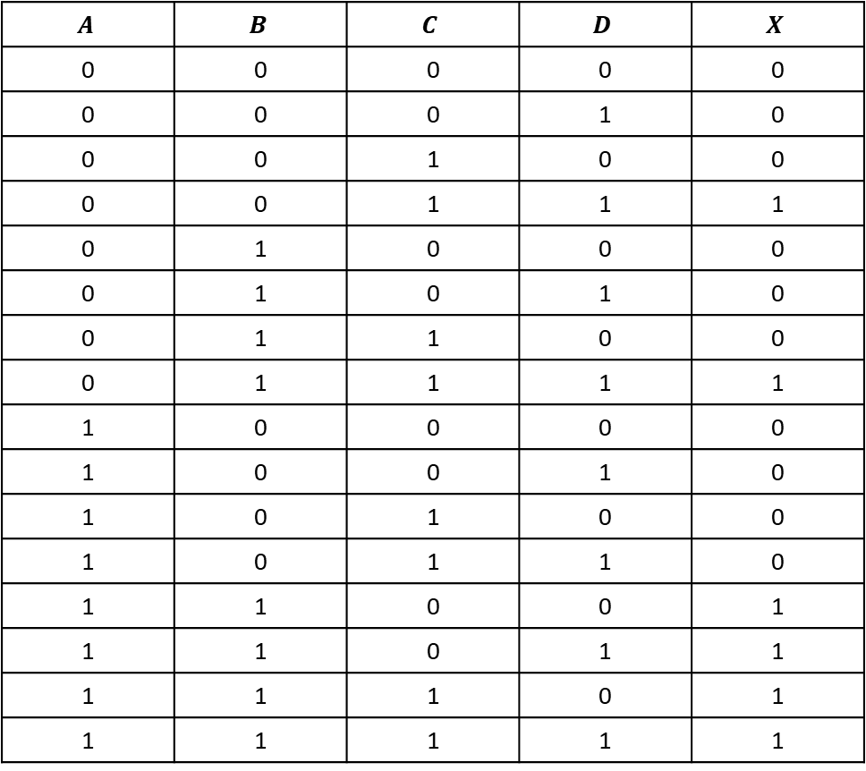
Sample 2
Assignment # 2
$$A$$ | $$B$$ | $$C$$ | $$D$$ | $$X$$
0 | 0 | 0 | 0 | 0
0 | 0 | 0 | 1 | 0
0 | 0 | 1 | 0 | 0
0 | 0 | 1 | 1 | 1
0 | 1 | 0 | 0 | 0
0 | 1 | 0 | 1 | 0
0 | 1 | 1 | 0 | 0
0 | 1 | 1 | 1 | 1
1 | 0 | 0 | 0 | 0
1 | 0 | 0 | 1 | 0
1 | 0 | 1 | 0 | 0
1 | 0 | 1 | 1 | 0
1 | 1 | 0 | 0 | 1
1 | 1 | 0 | 1 | 1
1 | 1 | 1 | 0 | 1
1 | 1 | 1 | 1 | 1
Provide Minterms
Provide Maxterms
Standard SOP equation
Standard POS equation
Waveform diagram
Logic diagram
Logic diagram using only NAND gates
Draw Karnaugh map
Find minimal SOP equation using Karnaugh map
Represent the minimal SOP equation in Canonical form

Slide 41



THANK YOU
Owais Hussain
+92 345-3174270
owais.hussain@kiet.edu.pk
https://www.researchgate.net/profile/Owais-Hussain-3

